Slide 1


Bank Churn Prediction Analysis
This presentation analyzes a bank churn dataset to predict customer attrition. The goal is to identify key factors influencing churn and develop an effective prediction model.
by Jyoti Sahu

Slide 2

Data Exploration and Preprocessing
The dataset contains 10,000 entries with 13 columns. Initial steps involved examining the data shape, data types, and identifying missing values.
There were no missing or duplicate values.
Insignificant features like CustomerId and Surname were dropped.
Numerical features such as Age, Balance, CreditScore, and EstimatedSalary were converted to integer types and grouped into bins for better analysis.
Data Shape
Missing Values
Duplicate Rows
Class Imbalance
(10000, 13)
No missing values
No duplicate records
Handled by using stratify

Slide 3

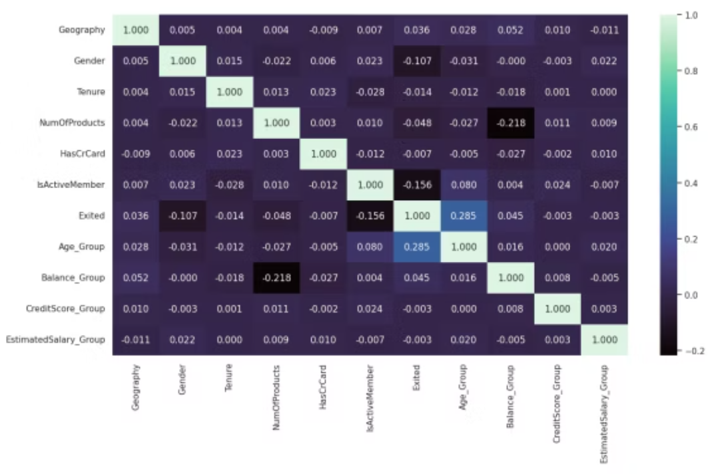
Exploratory Data Analysis (EDA)
Correlation Matrix
The analysis revealed no significant correlation between the independent variables.
A moderate correlation was observed between the target variable and the Age_Group independent variables.

Slide 4






Churn Analysis by Feature
Geography
Germany has higher churn (32%).
Gender
Female customers churn more (25%).
NumOfProducts
Customers with 4 products churn 100%.
Tenure
Tenure of zero years churn more.
Age
Customers in this range 56-65 churn more.

Slide 5






Churn Analysis by Feature
IsActiveMember
Inactive members has higher churn.
Balance
Customers having Balance between 200001-250000 churn more.
EstimatedSalary
Customers with 4 products churn 100%.
CredictScore
Customers having CreditScore between 400-500 churn more.
HasCrCard
Customers having no credit card churn more.

Slide 6

Data Splitting and Scaling
Split Data
1
Independent and dependent variables.
Train/Test Split
2
80% training, 20% testing.
Scale Features
3
Using StandardScaler.

Slide 7

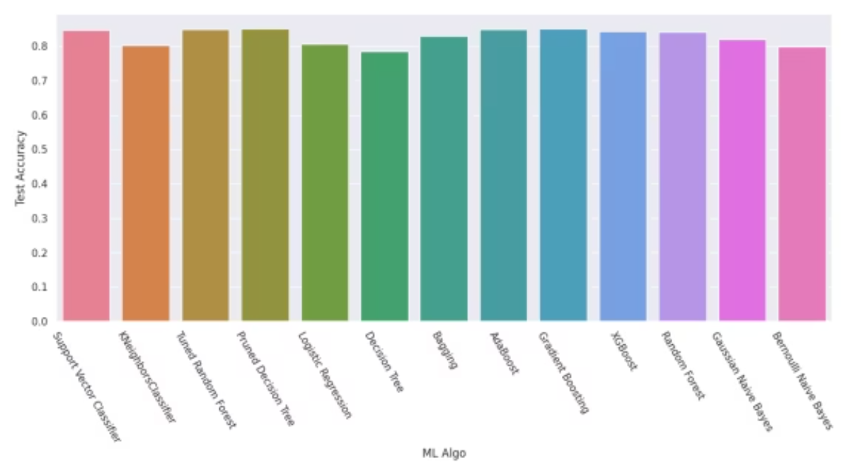
Model Building and Evaluation
Various machine learning models were built and evaluated, including Logistic Regression, Decision Tree, Bagging, AdaBoost, Gradient Boosting, XGBoost, Random Forest, Naive Bayes.
The evaluation function also addressed overfitting issues using cross-validation.
Hyperparameter Tuning - Pruning Decision Tree and Random Forest with GridSearchCV.

Slide 8

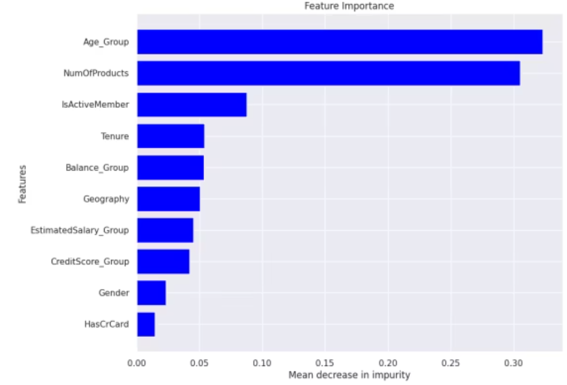
Feature Importance

Slide 9

Conclusion and Key Findings
XGBoost, Random Forest and Gradient Boosting performed
models
NumOfProducts, IsActiveMember and Age are most important features
The insights gained from this analysis can be used to develop targeted retention strategies and improve customer satisfaction.

Slide 10


